Slide 1
Automobile Selector
Team Torque: Priyanka Annapuready, Justin Wang, Rani Sebastian

Slide 2

Introduction
Shopping for a car is seriously challenging these days due to the sheer volume of options.
Goal: a model that can highlight the relationships between fuel consumption and other attributes.

Slide 3
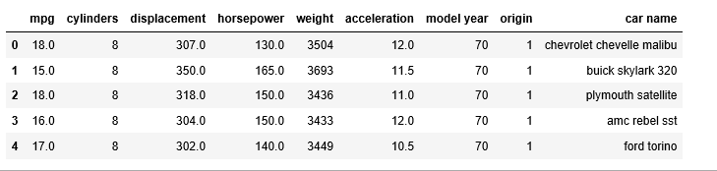
Dataset
Auto-mpg dataset
Contains data between 1970-1982

Slide 4
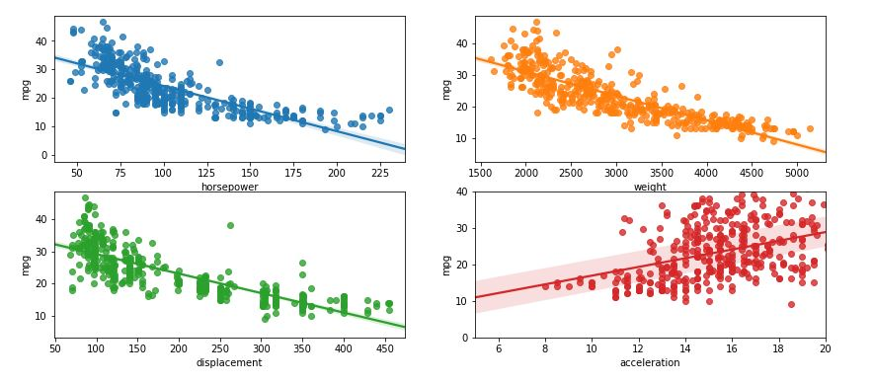
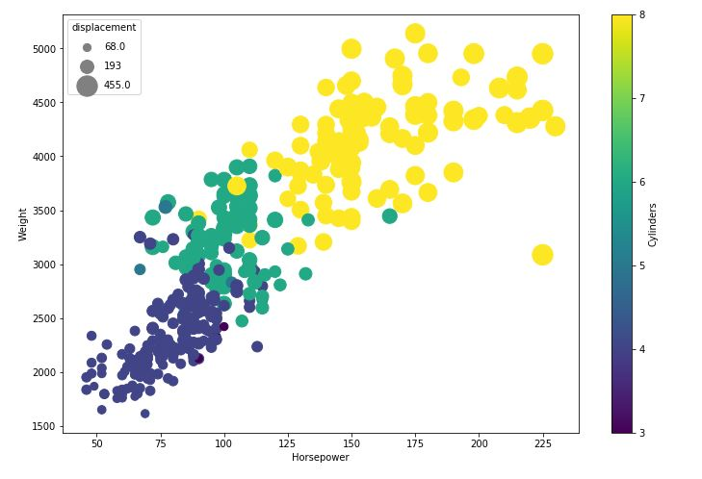
Exploratory Data Analysis
EDA highlights the linear relationship mpg has with various attributes:

Slide 5
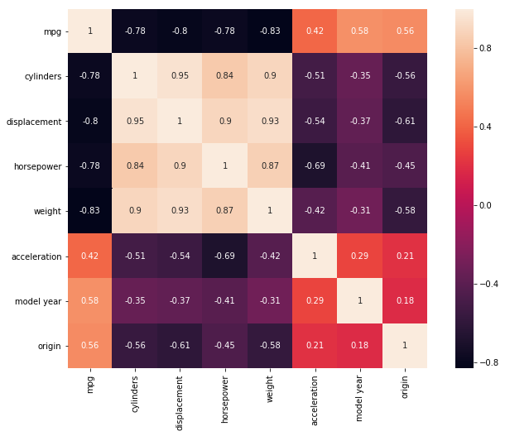

Slide 6
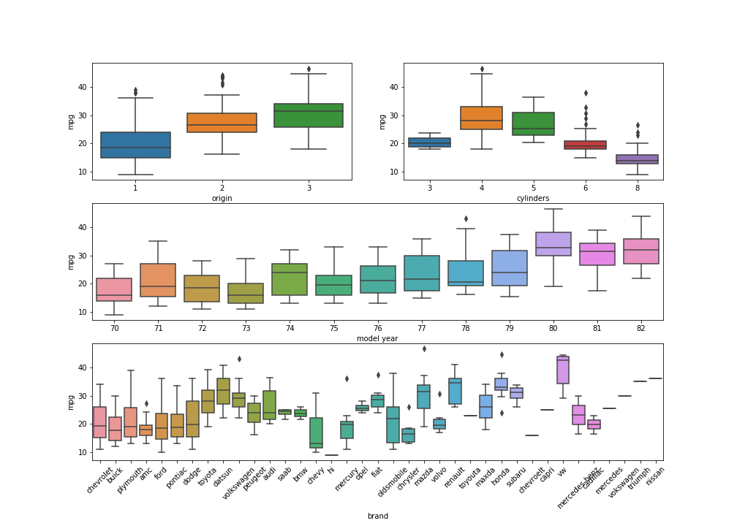

Slide 7
RoadMap
Apply Linear Regression concepts, since we find high linearity between the predictors and output variables.
Try Ensemble method random forest to select models and use RMSE or k-fold to evaluate.
Explore Lasso and Ridge Regression techniques.
Explore Elasticnet concepts if time permits.

